Slide 1
Sheet Music Reader
TEAM_34
Team:
B Vaibhaw Kumar (2019112021)
Anish Gupta (2020701025) Adityakumar Sinha (2019102003)
Him Agarwal (2019102026)

Slide 2
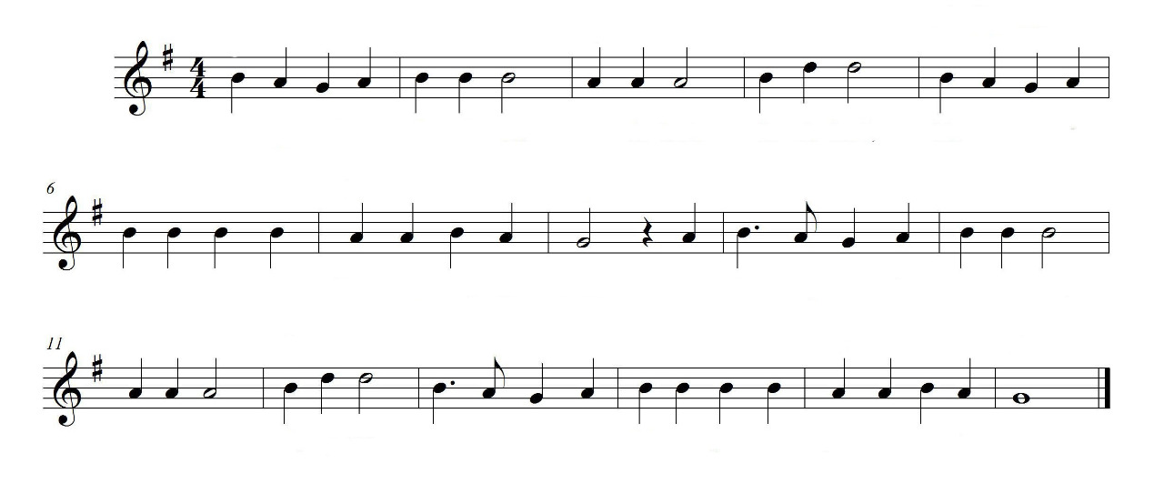

Objective
The goal of this project was to design an image processing algorithm that scans in sheet music and plays the music described on the page.
Algorithm Used

Slide 3
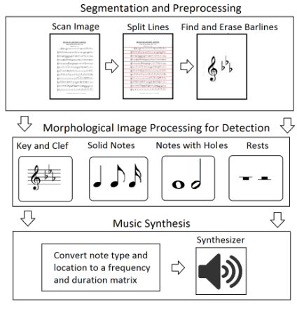
Methodology

Slide 4

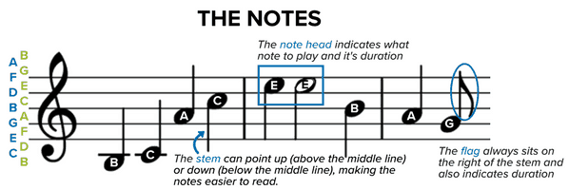


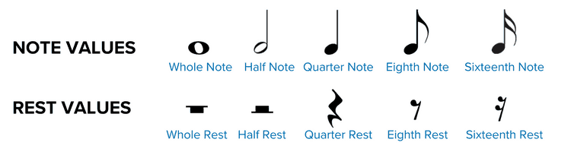
Music Sheet Basics

Slide 5
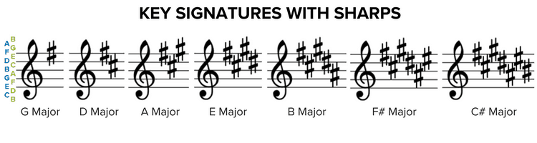
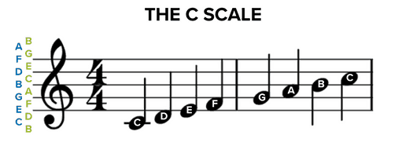
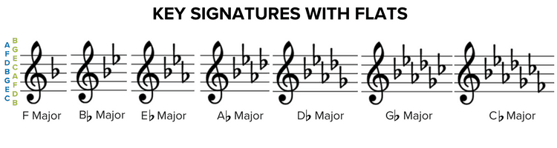
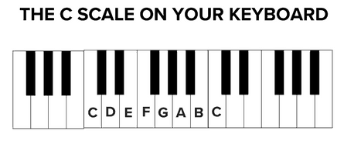
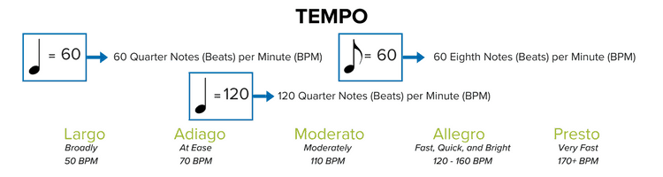
Music Sheet Basics

Slide 6
Segmentation and Preprocessing

Slide 7
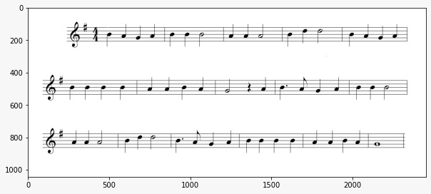
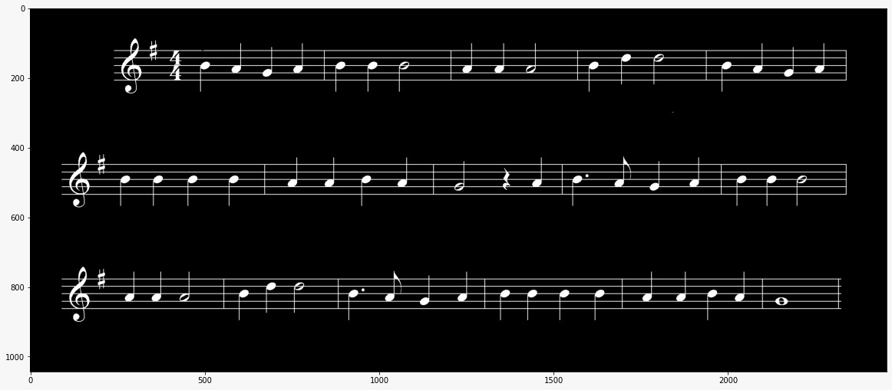

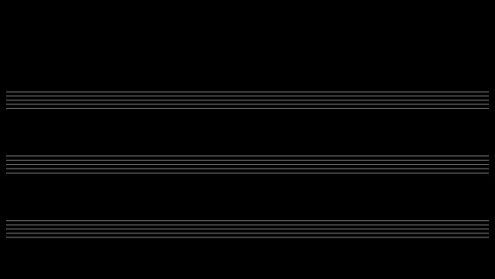
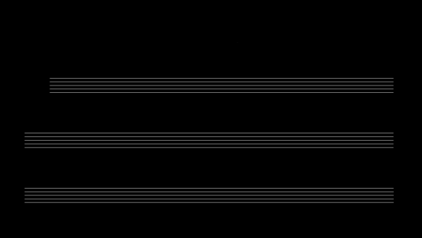
Segmentation and Preprocessing
Original Image
Binarized using Otsu’s Method
Inverted Image
Vertically Eroded
Horizontal Projection Image
Eroded image with only staff lines

Slide 8
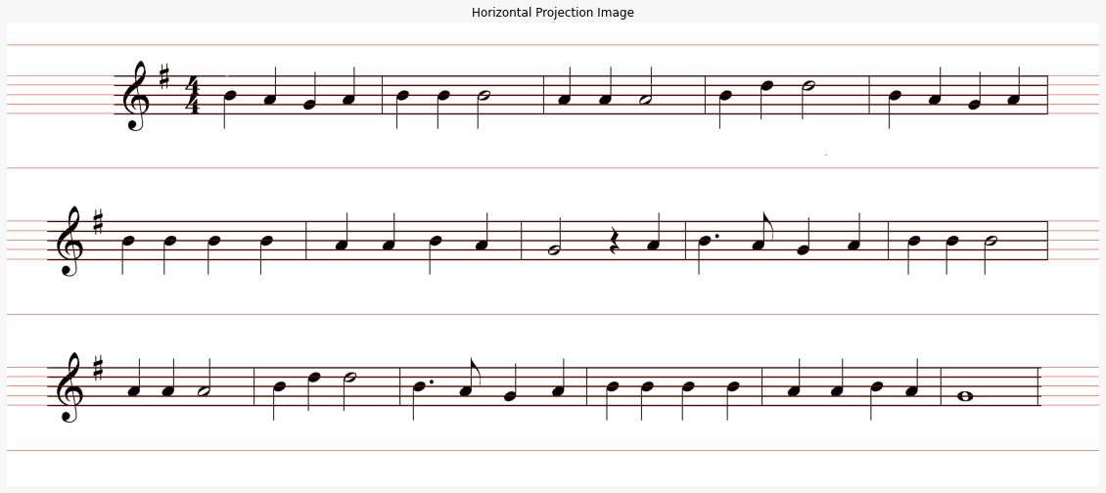
Segmentation and Preprocessing
Both will be used to get Image Segments and Staff Line Positions.
Image Segments and staff line positions are used by audio synthesizer later

Slide 9
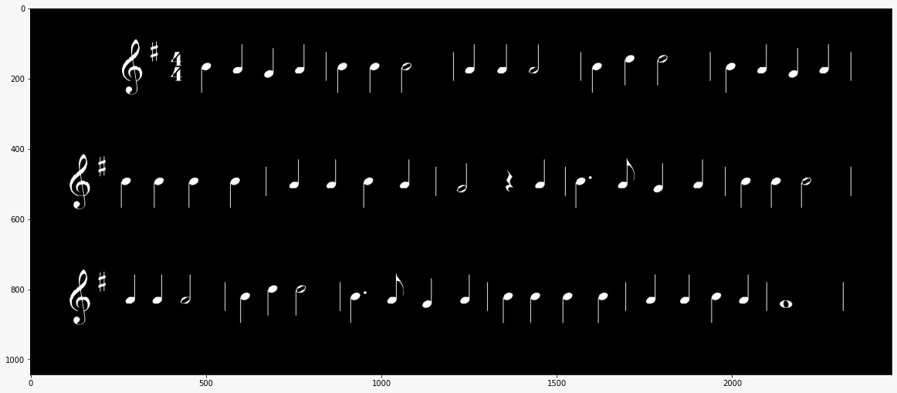
Segmentation and Preprocessing

Slide 10
Object Detection

Slide 11
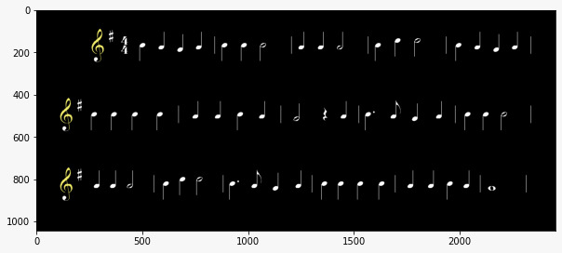
Cleft Detection
From the left side, the first element that the staves are touching is the cleft. We used DFS to detect the clefts.

Slide 12
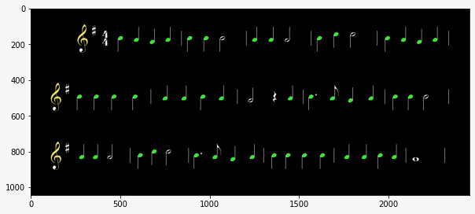
Quarter Note Detection
Opening by circular element

Slide 13
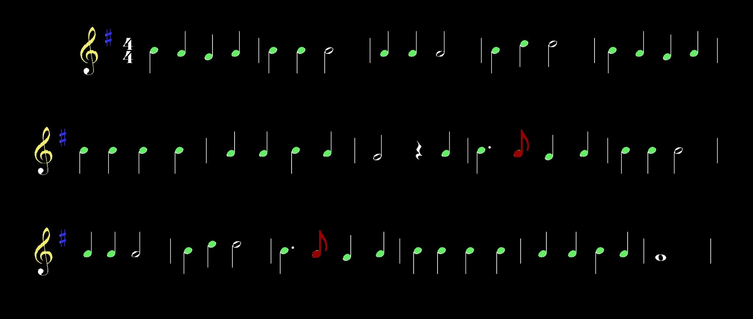
Key Note Detection
Opening with Vertical Structuring element with extrusion on either side

Slide 14
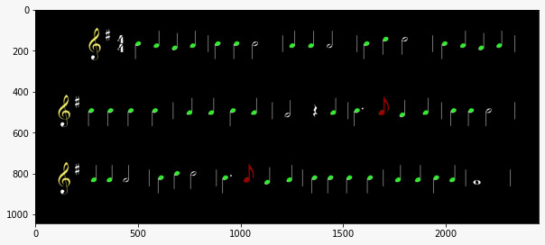
Eighth(Quaver) Note Detection
Opening with Vertical Structuring element with extrusion on either side

Slide 15
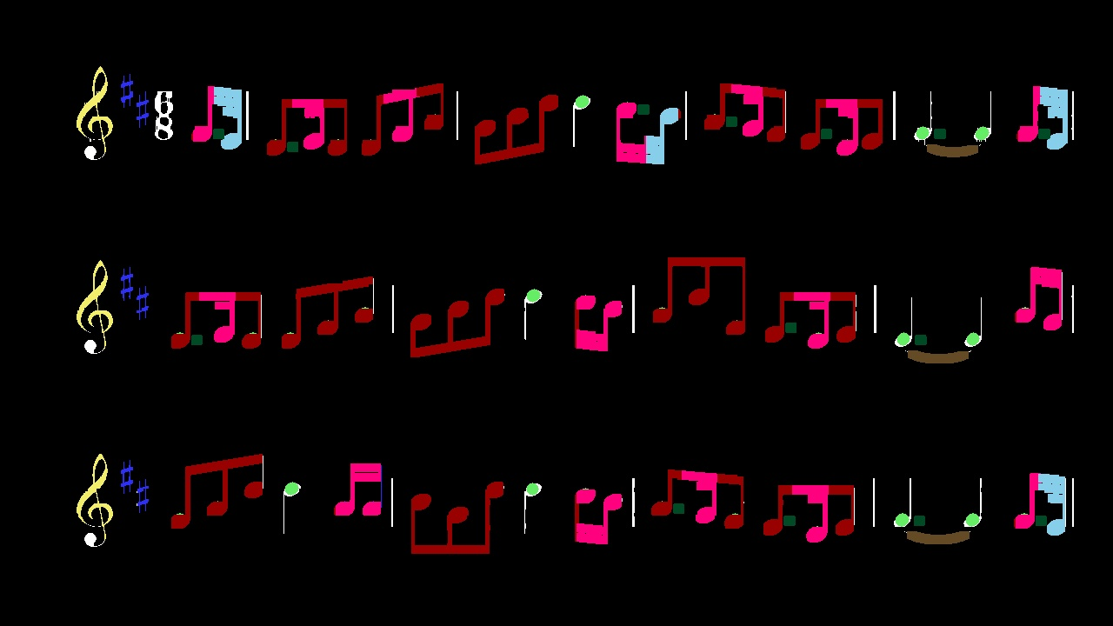
1/16th(SemiQuaver) Note Detection
Dividing image into segments by the intensity graph
Detecting beams as horizontal elements and the end points as circular elements using morphological opening

Slide 16
1/16th(DemiSemiQuaver) Note Detection
Dividing image into segments by the intensity graph
Detecting multiple beams as horizontal elements and summing them on the vertical side
Assigning it to corresponding dot

Slide 17
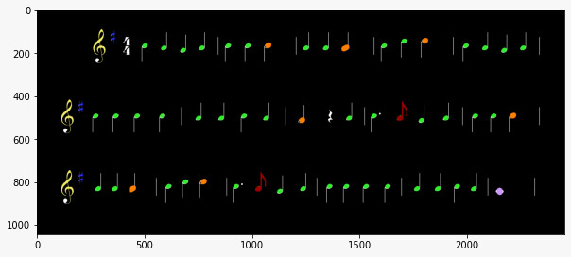
Whole Note and Half Note Detection
We did dilation with rectangle structuring element
violet - whole note, orange - half note

Slide 18
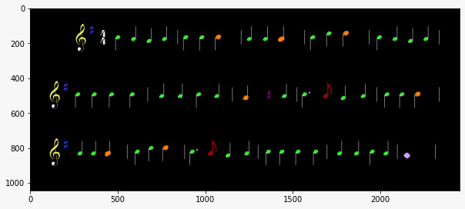
Rest Detection
Opening by Vertical line
2. Opening by Horizontal line
3. Pixels whose variance in vertical direction is maximum

Slide 19
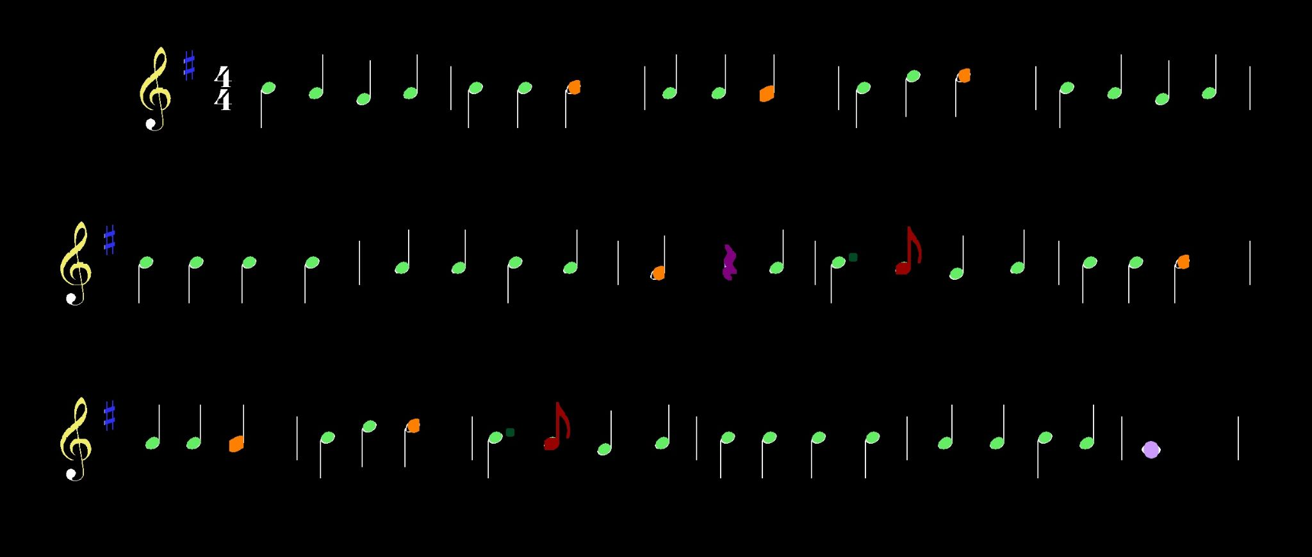
Dotted Points Detection
Removing vertical segments and noise using morphological opening.
Using 4 connectivity operation to separate objects
Detecting the dots as the point in specific area range

Slide 20
Tie Detection
Removing vertical segments and noise using morphological opening
Using 4 connectivity operation to separate objects
Applying morphological opening on V shaped object
Selecting the bottom centroid object
Detecting the ties as the point in specific area range

Slide 21
Music Synthesis

Slide 22
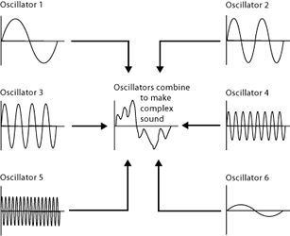
PySynth
Additive synthesis based music synthesis
As the goal is able to detect notes so we have scripts that can turn ABC notation or MIDI files into a WAV file without too much tinkering.

Slide 23
Pysynth
Color labels to centroids of the connected components
Find nearest neighbour staff
If two staves are of similar distance then its in the space of the staves
List of frequencies from the staves and duration from the type of notes is given to pysynth

Slide 24
Limitations
This algorithm is largely missing the handling of accidentals that are not described in the key signature at the beginning of each line.
There are some musical symbols that are not even mentioned in this algorithm, such as the dynamics markings, time signatures, triplet groupings, and accents.
Dots and Whole and Half notes may cause problems in each others detection

